Slide 1
Fractional Diffusion
Ed McDonald & Adam J. Gray
Lecturer: Dr Peter Straka
Never Stand Still
Faculty of Science
Mathematics and Statistics

Slide 2
Overview
What is fractional diffusion?
How do we solve fractional diffusion problems?
Where does fractional diffusion occur?

Slide 3
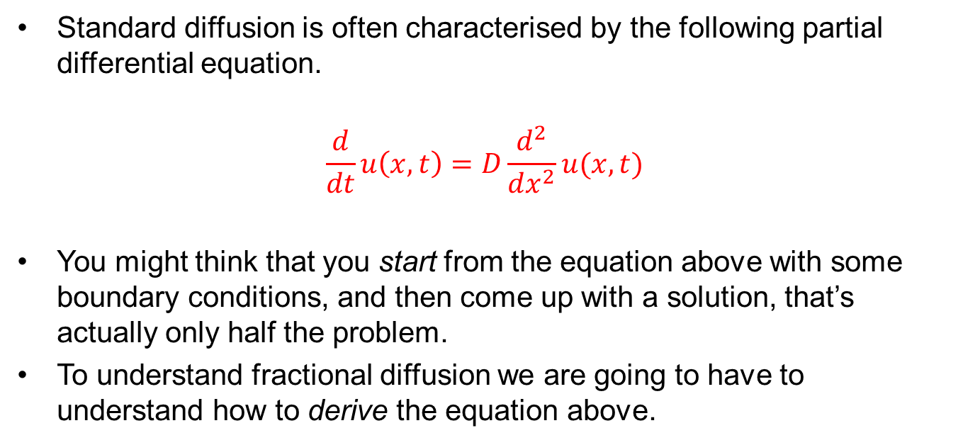
Standard Diffusion
Standard diffusion is often characterised by the following partial differential equation.
$$\frac{d}{dt}u\left(x,t\right)=D\frac{d^{2}}{dx^{2}}u(x,t)$$
You might think that you start from the equation above with some boundary conditions, and then come up with a solution, that’s actually only half the problem.
To understand fractional diffusion we are going to have to understand how to derive the equation above.

Slide 4
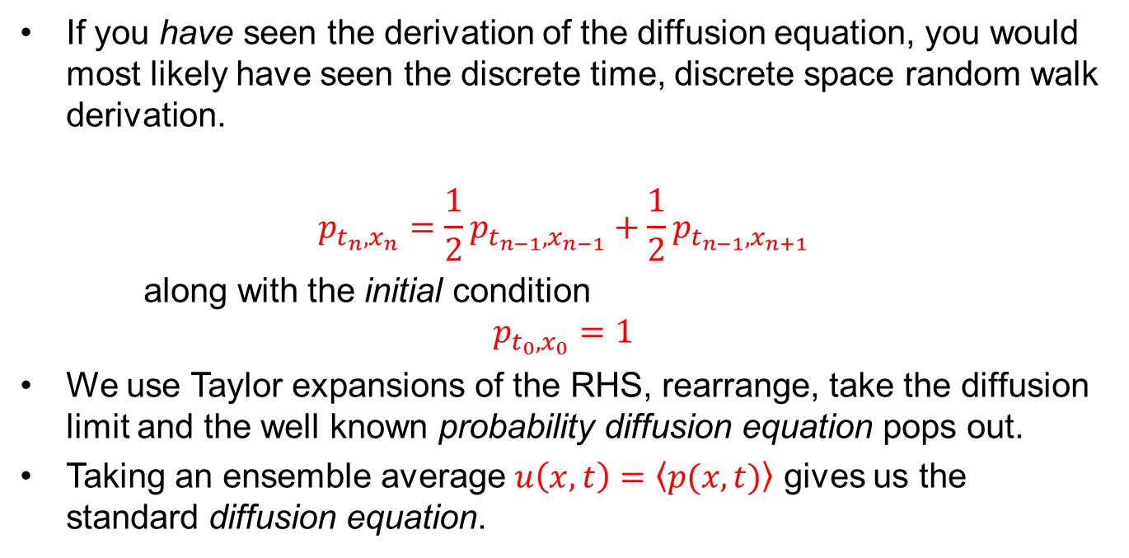
Random Walk Derivation
If you have seen the derivation of the diffusion equation, you would most likely have seen the discrete time, discrete space random walk derivation.
$$p_{t_{n},x_{n}}=\frac{1}{2}p_{t_{n−1},x_{n−1}}+\frac{1}{2}p_{t_{n−1},x_{n+1}}$$
along with the initial condition
$$p_{t_{0},x_{0}}=1$$
We use Taylor expansions of the RHS, rearrange, take the diffusion limit and the well known probability diffusion equation pops out.
Taking an ensemble average $u\left(x,t\right)=\left\langle p(x,t)\right\rangle$ gives us the standard diffusion equation.

Slide 5
Continuous Time Random Walks
What we looked at before was the discrete time random walk.
Instead of saying that a particle jumps at every time step, we simply say that each particle jumps after waiting for some period of time between jumps.
This waiting time is random and the distribution that the waiting time comes from is called the jump time distribution.

Slide 6
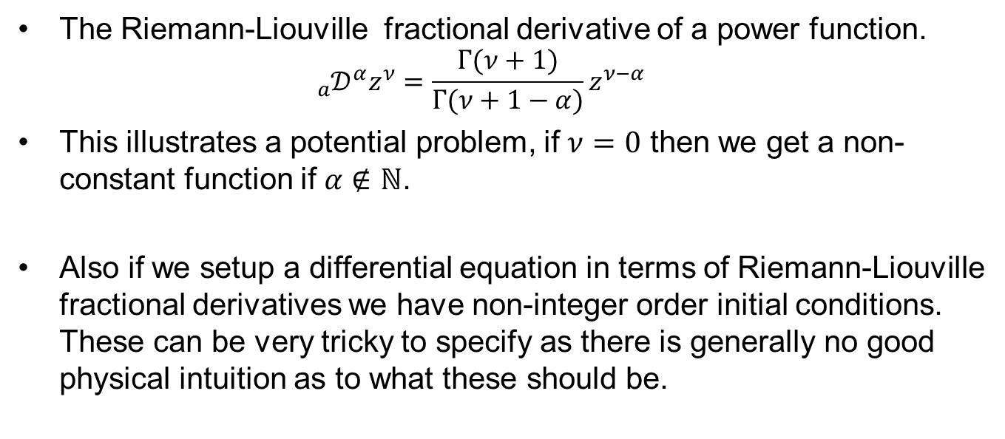
Riemann-Liouville continued…
The Riemann-Liouville fractional derivative of a power function.
$${{}_{a}^{}𝒟}^{α}z^{ν}=\frac{Γ(ν+1)}{Γ(ν+1−α)}z^{ν−α}$$
This illustrates a potential problem, if $ν=0$ then we get a non-constant function if $α∉ℕ$.
Also if we setup a differential equation in terms of Riemann-Liouville fractional derivatives we have non-integer order initial conditions. These can be very tricky to specify as there is generally no good physical intuition as to what these should be.

Slide 7
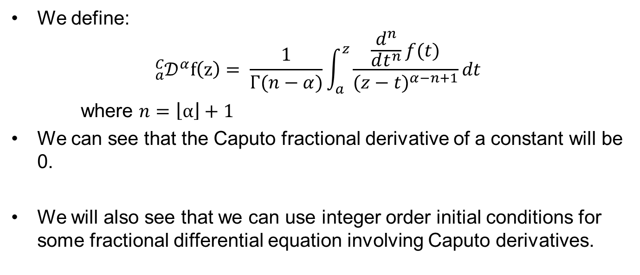
Caputo
We define:
$${{}_{a}^{C}𝒟}^{α}f\left(z\right)= \frac{1}{Γ(n−α)}\int_{a}^{z}{\frac{\frac{d^{n}}{dt^{n}}f(t)}{{(z−t)}^{α−n+1}}dt}$$
where $n=\left\lfloor α\right\rfloor +1$
We can see that the Caputo fractional derivative of a constant will be 0.
We will also see that we can use integer order initial conditions for some fractional differential equation involving Caputo derivatives.

Slide 8
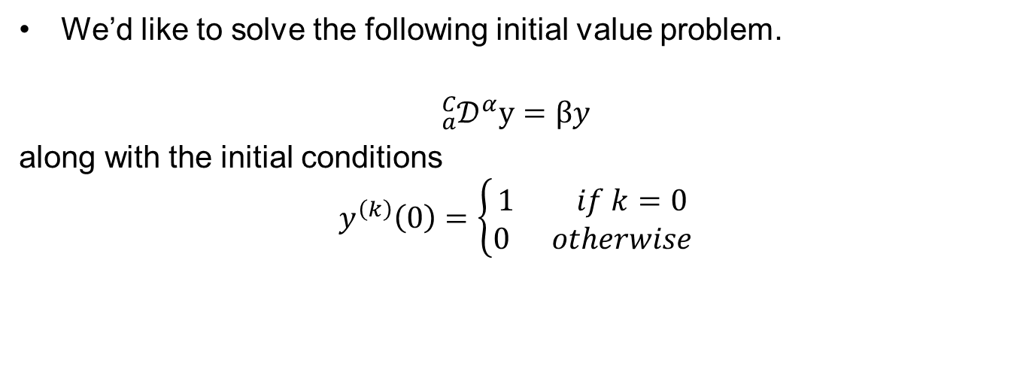
Linear ordinary fractional differential equation
We’d like to solve the following initial value problem.
$${{}_{a}^{C}𝒟}^{α}y=βy$$
along with the initial conditions
$$y^{\left(k\right)}\left(0\right)=\left\{\begin{aligned}1 if k=0 \\ 0 otherwise\end{aligned}\right.$$

Slide 9
Linear ordinary fractional differential equation continued…
These problems are much easier to solve in Laplace space, than they are by manually evaluating and manipulating the integrals.
In fact many results in fractional calculus which would otherwise require 3 – 4 page proofs can be proved in just 5-6 lines in Laplace space.
We will have to introduce a collection of new ideas to solve the IVP.

Slide 10
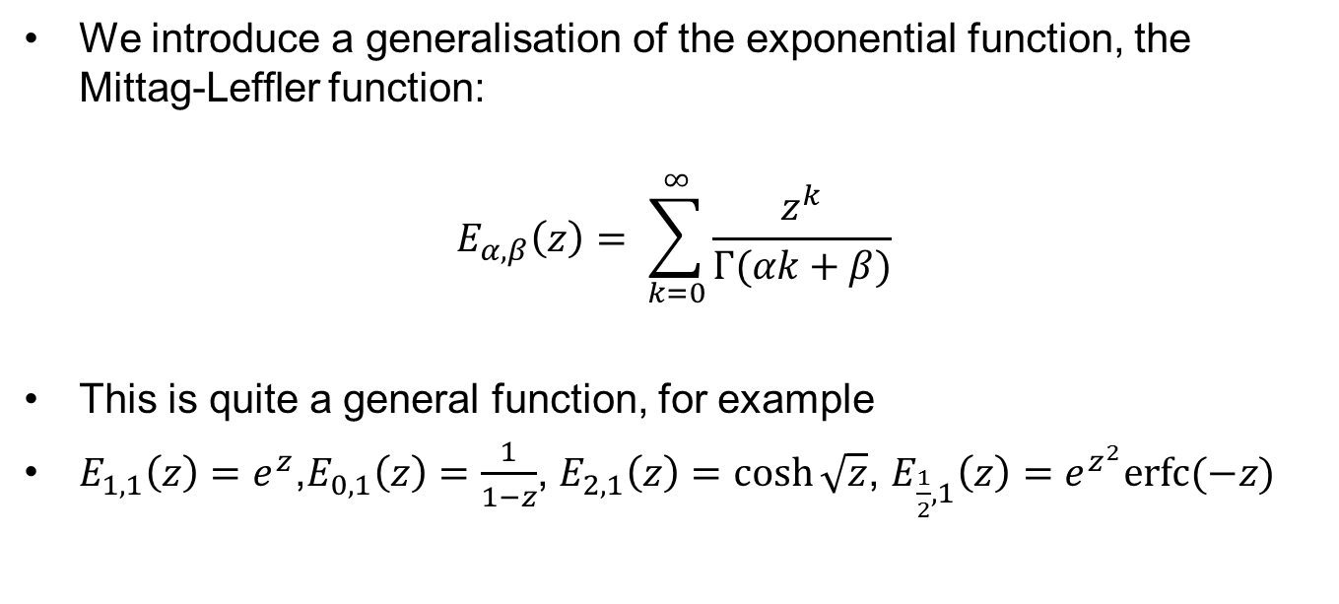
Mittag-Leffler Function
We introduce a generalisation of the exponential function, the Mittag-Leffler function:
$$E_{α,β}\left(z\right)= \sum_{k=0}^{∞}{\frac{z^{k}}{Γ(αk+β)}}$$
This is quite a general function, for example
$E_{1,1}\left(z\right)=e^{z}$,$E_{0,1}\left(z\right)=\frac{1}{1−z}$, $E_{2,1}\left(z\right)=\cosh{\sqrt{z}}$, $E_{\frac{1}{2},1}\left(z\right)=e^{z^{2}}erfc⁡(−z)$

Slide 11
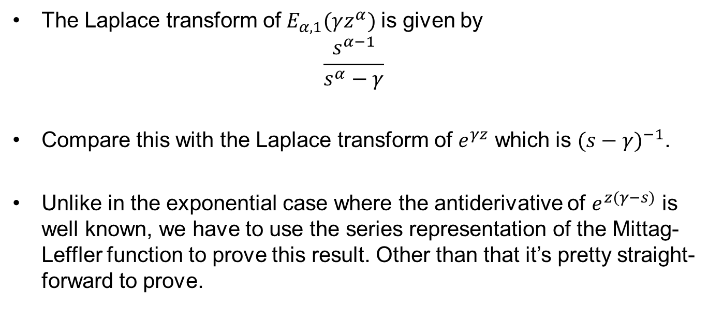
Mittag-Leffler Function continued…
The Laplace transform of$E_{α,1}(γz^{α})$ is given by
$$\frac{s^{α−1}}{s^{α}−γ}$$
Compare this with the Laplace transform of $e^{γz}$ which is ${(s−γ)}^{−1}$.
Unlike in the exponential case where the antiderivative of $e^{z(γ−s)}$ is well known, we have to use the series representation of the Mittag-Leffler function to prove this result. Other than that it’s pretty straight-forward to prove.

Slide 12
Laplace Transform of Caputo Derivative

Slide 13
Thankyou

